Slide 1


DEVELOPMENT OF AN AUTOMATED TEXT TO SPEECH FOR VISUALLY IMPAIRED
Batch : Kingsly Kirubakaran L 953219106014
Members Kishore Anton M 953219106015
Siva Kumar T 953219106035
Sivanraj M 953219106036
Supervisor : Dr.A.Mookambiga M.Tech., Ph.D

Slide 2
OUTLINE
Introduction
Need for this project
Literature survey
Challenges
Objectives
Methodology
6.1 Flowchart
6.2 Description

Slide 3
OUTLINE
Hardware Implementation
7.1 Block Diagram
7.2 Description
8. Result
Conclusion
Future scope
References

Slide 4
1. INTRODUCTION
Reading is an essential skill for learning, communication, and daily living.
However for individuals with reading difficulties, visual impairments, dyslexia, accessing text can be a challenging and time-consuming task.
The Optical Character Recognition (OCR) allows us to convert printed or handwritten text into machine-readable digital text.
Translator can translate text from one language to another language.
Text to Speech (TTS) technology converts translated text into spoken words, allowing users to listen to text.
By incorporating OCR, Translator, and TTS technology into Raspberry pi, users can create a low-cost, portable, and customizable system for converting text into speech.

Slide 5
2. NEED FOR THIS PROJECT
With the increasing globalization and interconnectivity of the world, it is becoming increasingly essential to be able to read, understand, and communicate in different languages.
However, language barriers can be a significant obstacle for many people, including those who are visually impaired or have reading difficulty.
This project aims to overcome these barriers by providing a tool that can recognize and translate text from images, scanned documents, or handwritten notes in various languages.
Additionally, the text can be converted to speech, allowing users to listen to the content and improve their language skills.
This project has numerous practical applications in various fields such as education, business, and healthcare, where multilingual communication is essential.

Slide 6
3. LITERATURE SURVEY
Title of the paper | Author and journal | Description | Summary | Limitation
A Review on Text-to-Speech Converter June 2022 | Dr.S.A.Ubale, Girish Bhosale, Ganesh Nehe, Avinash Hubale, Avdhoot Walunjkar | This paper in short discusses the specific textual content-to-speech engines. TTS technology converts digital text into audio on devices and is a Python library. | Speech-to-text conversion is becoming more common and can be easily created using Python programming language. | Pronunciation analysis from written text is a major concern. The resulting speech is less than the Naturalness and Emotionless.
A Survey on “Text-to-Speech Systems for Real-Time Audio Synthesis” June 2021 | Prof. Mrunalinee Patole, Akhilesh Pandey, Kaustubh Bhagwat, Mukesh Vaishnav, Salikram Chadar | Detect the text on real time and generate into speech. Used the CNN algorithm. | This paper in short discusses the specific textual content-to-speech engines, consisting of tacotron and tacotron2. | Text-to-speech engines lacks speech naturalness, intonation, and multilingual support.

Slide 7
Title of the paper | Author and journal | Description | Summary | Limitation
Text Reader for Visually Impaired Using Google Cloud Vision API May 2018 | Paras Doshi, Yash Shirke, Tejas Hegde, Pranav Dhanvij | The visually impaired face daily challenges, but technology can help with Braille, magnifiers, and text-to-speech. Our proposed system uses Google Cloud Vision API to extract text from challenging images and convert it into synthetic speech for easier reading. | This system extracts text from images and converts it to speech, recognizing various fonts and even skewed text. It uses a smartphone camera for better resolution. | In this model the time required for the processing takes more in time. Cursive characters cannot be recognized.
A Review on Text-to-Speech System March 2022 | Vaishnavi R.Ambaskar, Vinod M. Lokhande, Dr. Avinash S. Kapse | This paper aims to provide a unidirectional communication interface between the computer and the user, where the computer reads out a document for the user's quick understanding and reading development | Here they review about STT,TTS and speech translator. HMM works much better speech signal to convert text | It is hard to deal with rule interact in big systems, ambiguity, and idiomatic expressions. Insufficient amount of really good dictionaries.

Slide 8
Title of the paper | Author and journal | Description | Summary | Limitation
A Recent Survey Paper on Text-To-Speech Systems January 2023 | Shruti Mankar, Nikita Khairnar, Mrunali Pandav, Hitesh Kotecha, Manjiri Ranjanikar | The process involves converting text into an abstract linguistic representation and then using rules to transform phonemes into sound. | This paper is a literature review of different approaches to developing efficient TTS systems, including their pros and cons, algorithms used, and other details. | Unable to Convert webpages into any form of speech output
Survey paper: Text To Speech conversion for visually impaired peoples June 2021 | Nisha P, Dr.J.Vijayakumar | The research aims to assist visually impaired people's achieved through the use of OCR, Raspberry Pi, MATLAB, and open CV library. | This paper involves capturing the image, localizing text, and convert into audio output. | Correctness of grammar and meaning of text results poor.

Slide 9
Title of the paper | Author and journal | Description | Summary | Limitation
Text to Speech Conversion using Optical Character Recognition July 2020 | Sharvari S, Usha A, Karthik P, Mohan Babu C | This project aims to create an OCR system using a Raspberry Pi to help the blind read books, understand text on banners and ad boards, and more. This system captures images using a camera connected to the Raspberry Pi and converts them to text using the Tesseract OCR library. | This research work provides numerical data that supports the theory that maintaining the integrity of the position of syllables during concatenation is crucial for naturalness in TTS synthesis. | Handwritten text cannot be recognized by the OCR engine.
The Application of Text-to-Speech Technology in Language Learning 2021 | N. Haristiani et al | This article explores the use of TTS technology in language learning, highlighting its positive impact on knowledge transfer and improving language skills. | The analysis revealed that while TTS technology lacks intonation and real-time class interaction, it can still be a break through in supporting language learning. | Lack of naturalness, pleasantness, expressiveness, and intonation in TTS

Slide 10
Title of the paper | Author and journal | Description | Summary | Limitation
Handwritten Character Recognition Using Convolutional Neural Network 2021 | Chooi Shir Ley, Aimi Syammi Binti Ab Ghafar | This paper applies a machine learning technique for handwritten character recognition. Using Keras as the backend and Tensorflow as the software | The project has proposed for recognizing the handwritten character with accuracy of 88.00% using EMNIST dataset | It gives handwritten output only for the given EMNIST dataset.
Text to Speech Conversion Using Google Vision API December 2021 | Karun Somasunder M, Amal J.S, Gopal Gopakumar, Suraj V Thomas, Keerthi Krishnan | The paper describes an assistive device that uses OCR technology to extract text from captured images and convert it to speech through text-to-speech software. The device aims to assist people with text-based communication by providing a voice-based output. | The system uses OCR technology to extract text from images, including skewed or handwritten text, and converts it to speech using Google Vision API. | User unable to convert the speech to their preferred language.

Slide 11
4. CHALLENGES
Accuracy: OCR technology may struggle with recognizing characters accurately, especially if the image has poor quality, unusual fonts or poor handwritten text. This can affect the accuracy of the OCR engine and the quality of the extracted output.
Language translation: Translation is a complex process that involves not just converting words from one language to another, but also understanding the nuances of the language, including grammar, syntax, and cultural context. The challenge is to ensure that the translated text accurately conveys the intended meaning of the original text.

Slide 12
4. CHALLENGES
Text-to-Speech Quality: Text-to-speech technology has come a long way in recent years, but it can still be difficult to produce speech that sounds natural and is easy to understand, particularly in languages with complex phonetic and tonal systems.
Integration of different technologies: Integrating OCR, translation, and text-to-speech technologies can also be a challenge. Each technology may have its own unique requirements and limitations, and ensuring that they work seamlessly together can be difficult.

Slide 13
4. CHALLENGES
Portability: The device should be small, lightweight, and easy to carry, so that it can be used on the go.
Cost: The cost of the pen should be affordable and accessible to a wide range of users.
User Interface: The system should be intuitive, easy to use, and provide high-quality text extraction, translations and speech output.

Slide 14
5. OBJECTIVES
The overall objective of this project is to develop an automated text to speech for visually impaired people. The system is built considering the following design factors:
Accuracy: Using Google Cloud Vision API is to leverage its powerful OCR technology to accurately recognize printed characters in a variety of settings, even when the text is of poor quality, has unusual fonts or is handwritten.
Language Translation: Using Google Translator is to accurately translate text from one language to another, while taking into consideration the nuances of the language, including grammar, syntax, and cultural context.

Slide 15
5. OBJECTIVES
Text-to-Speech Quality: Using Google Cloud Text-to-Speech is to ensure high-quality speech output that sounds natural and is easy to understand, even in languages with complex phonetic and tonal systems.
Integration of different technologies: Using Raspberry Pi processor to overcome the challenges associated with technology integration, ultimately producing a robust and reliable system that can process OCR, translation, and text-to-speech tasks with minimal user intervention.
User Interface: The Device should be lightweight, easy to use, and provide high-quality text extraction, translations and speech output.

Slide 16
6. METHODOLOGY
6.1 FLOWCHART
START
OPEN CAMERA
CAPTURE IMAGE
PREPROCESS THE IMAGE
EXTRACT THE TEXT FROM THE IMAGE
TRANSLATE TEXT INTO PREFERRED LANGUAGE
SYNTHESIS TEXT INTO VOICE USING CLOUD TTS
STOP

Slide 17
6.2 Description
Capture Image: The camera will capture an image of the text and saving it in .jpg format using Python.
Pre-Process Image: The captured image will be pre-processed using OpenCV. This will involve converting the image to grayscale, applying thresholding to enhance the text, and removing noises from the image.
Extract Text: The pre-processed image will be passed to the Vision OCR to extract the text.
The Google Cloud Vision API is a machine learning service that allows you to integrate image analysis into your applications. It can recognize and extract information from images, such as text, logos, and objects, and convert it into machine-readable data.

Slide 18
6.2 Description
Translate Text: The extracted text will be passed to the Google Translate API to translate it into preferred language.
Google Translate uses AI and ML techniques to translate text. It works by analyzing patterns in documents that have already been translated by humans and identifying similar patterns in new texts. The system then uses these patterns to create translations that are as accurate as possible. The service supports over 100 languages.
Convert Text to Speech: The translated text will be passed to Google Cloud Text-to-Speech to convert it into speech.
The Google Cloud Text-to-Speech API uses deep neural network models to generate synthesized speech. These models are trained on large datasets of

Slide 19
6.2 Description
speech and text data to produce high-quality, natural-sounding speech that is indistinguishable from human speech. The API can also generate speech in real-time, making it ideal for applications that require fast and responsive speech output.
Output: The extracted and translated text will be displayed on the screen, and the device will play the generated speech output through speaker.

Slide 20
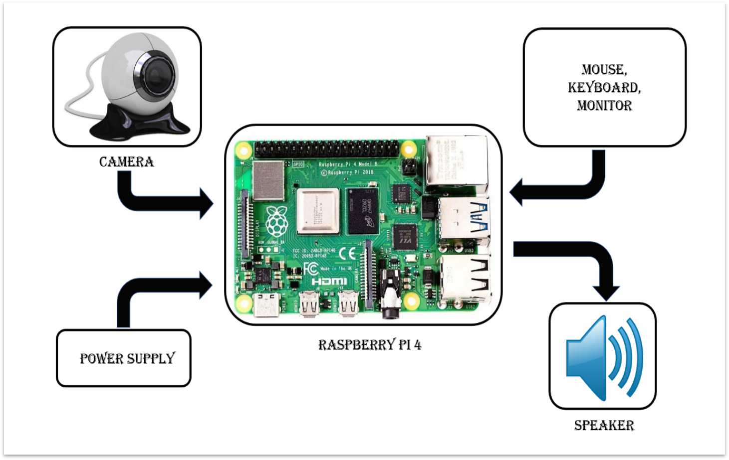
7.HARDWARE IMPLEMENTATION
7.1 BLOCK DIAGRAM

Slide 21
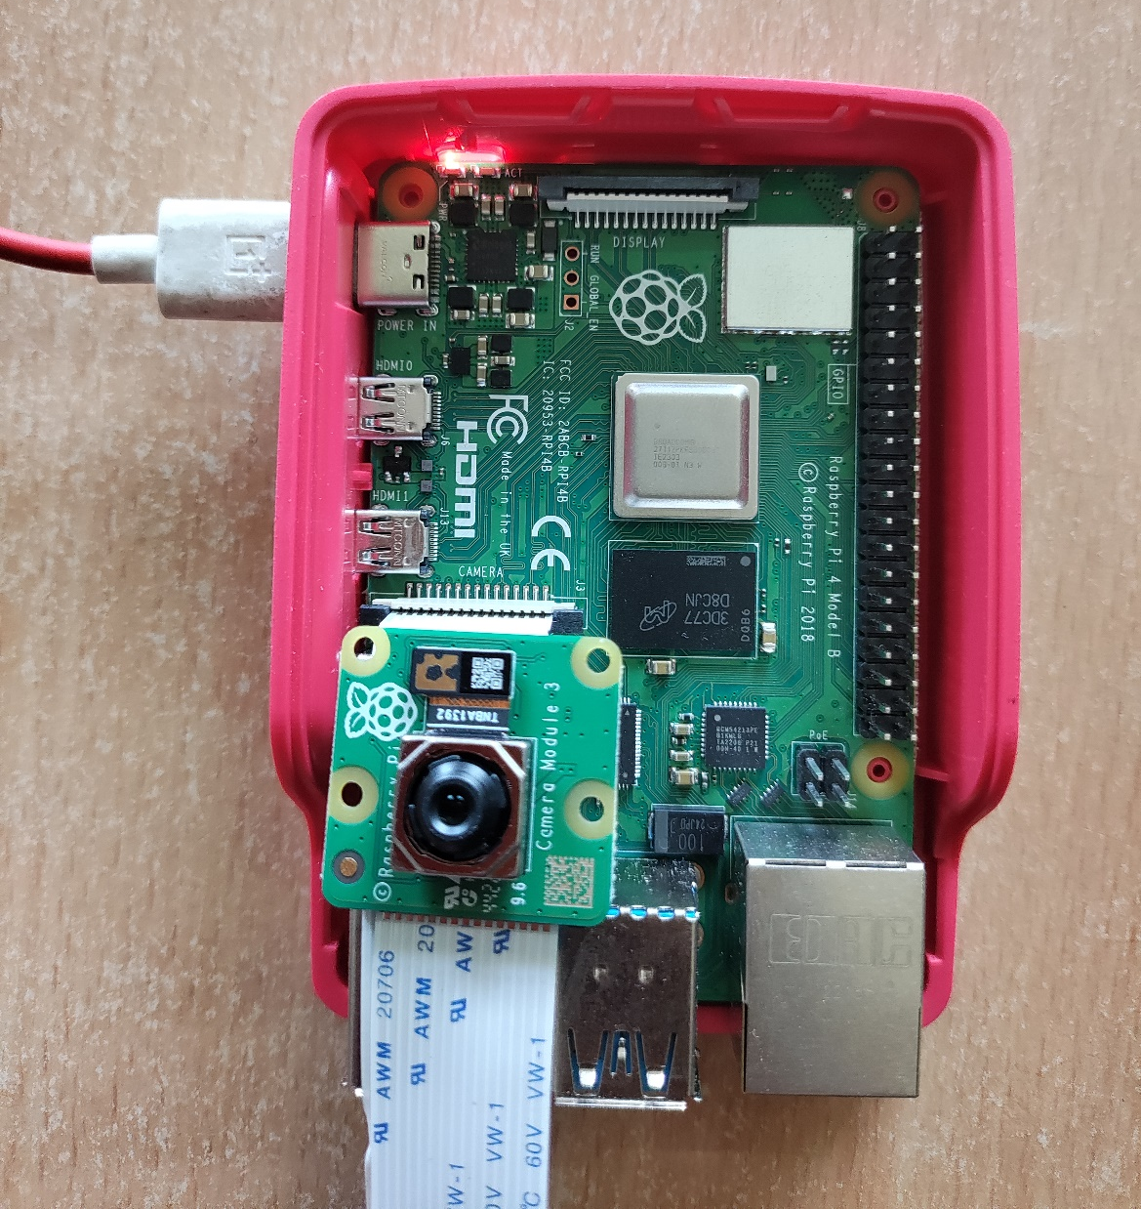
7.2 Description
Raspberry Pi 4 Model B
It is a versatile single-board computer that can be used to create a text to speech system. It features a powerful quad-core processor and up to 8GB of RAM, making it capable of handling complex speech synthesis algorithms. The board also has built-in Bluetooth and Wi-Fi, enabling it to connect to various audio devices.

Slide 22
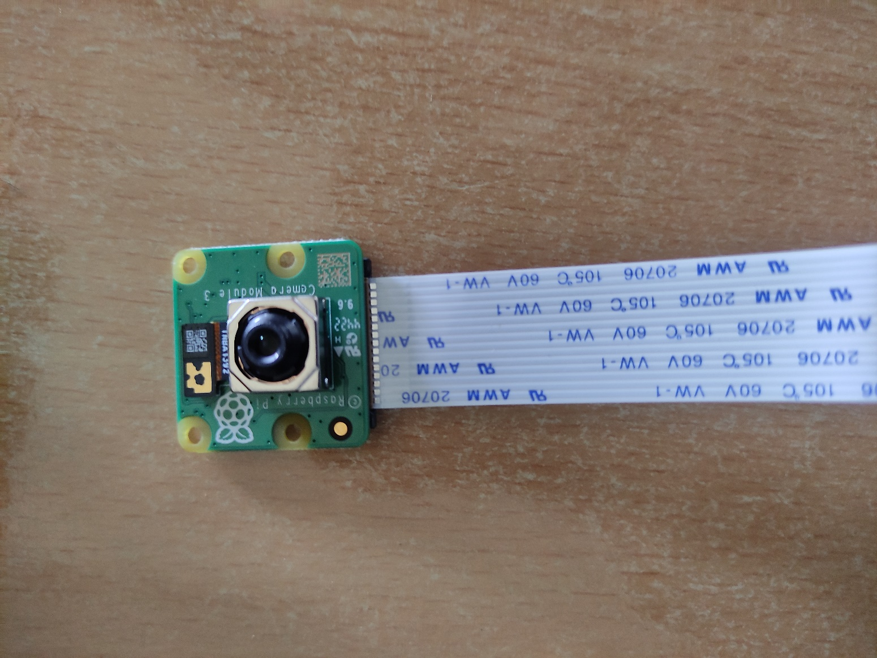
Raspberry pi camera V3 module
The Pi Camera V3 is a high-quality camera module designed specifically for the Raspberry Pi. It offers a resolution of up to 12 megapixels and can capture 1080p video at 50 frames per second. The camera is easy to connect to the Raspberry Pi's CSI port and can be controlled using the Pi's GPIO pins. It also supports various image processing features such as auto-exposure, white balance, and image stabilization.

Slide 23
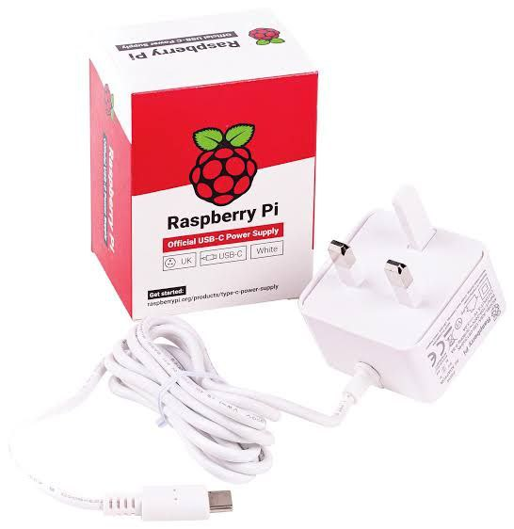
Power supply
The Raspberry Pi 4 Model B requires a 5-volt power supply with a USB-C connector capable of supplying at least 3 amps of current. The power supply must be capable of providing stable and reliable power to the board to prevent issues.

Slide 24
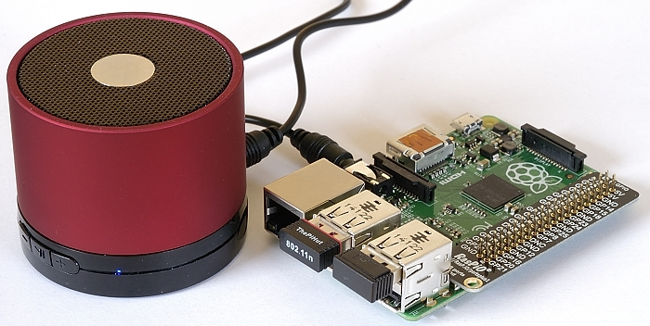
Audio Output
Audio Output - Audio can be played by a earphones connect in 3.5mm audio jack port provided in a raspberry Pi or can connect Bluetooth speaker via wireless.

Slide 25
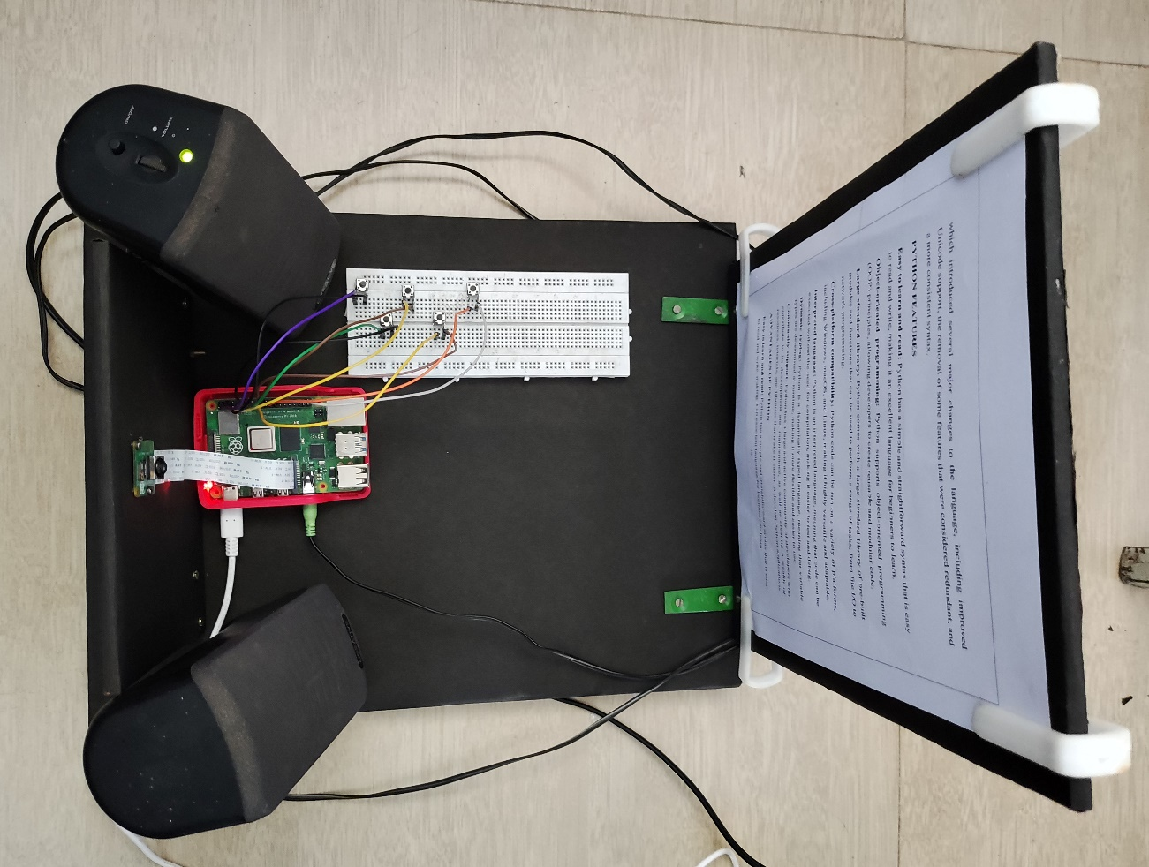
Connections and Hardware Setup
Connect the Power supply adaptor to the Raspberry Pi 4 via Type-C port.
Connect the PiCamera module to the Raspberry Pi 4 via the camera connector.
Connect the Speaker to the Raspberry Pi 4 via the USB port or Audio port.
Connect the Monitor to the Raspberry Pi 4 via HDMI cable. (optional)
Connect the Keyboard and Mouse to the Raspberry Pi 4 via USB port. (optional)

Slide 26
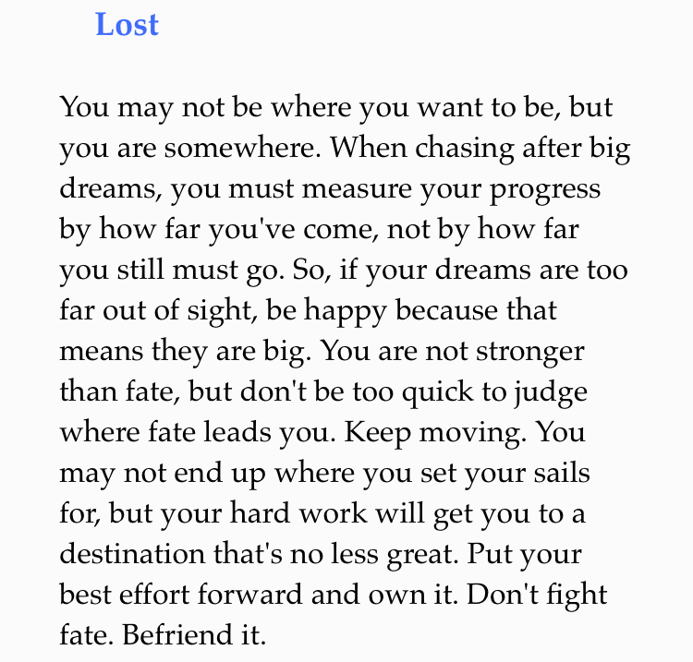
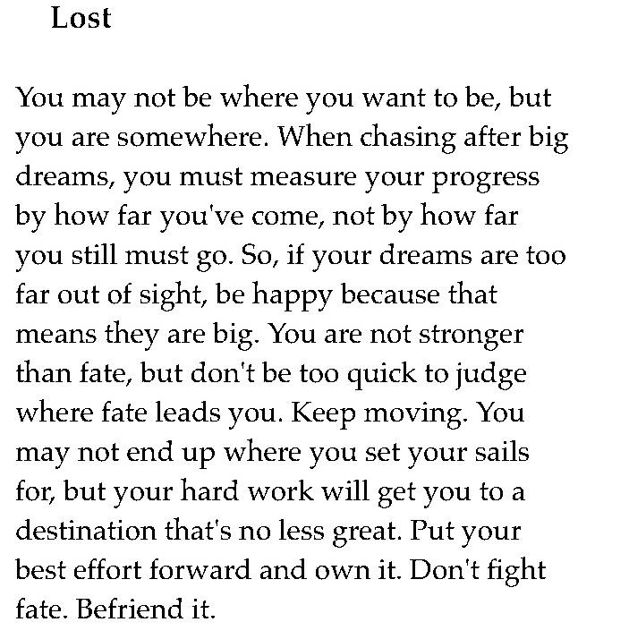
8. RESULT
Test Case 1: Input image contain printed English text
Input Image
Pre-processed Image

Slide 27
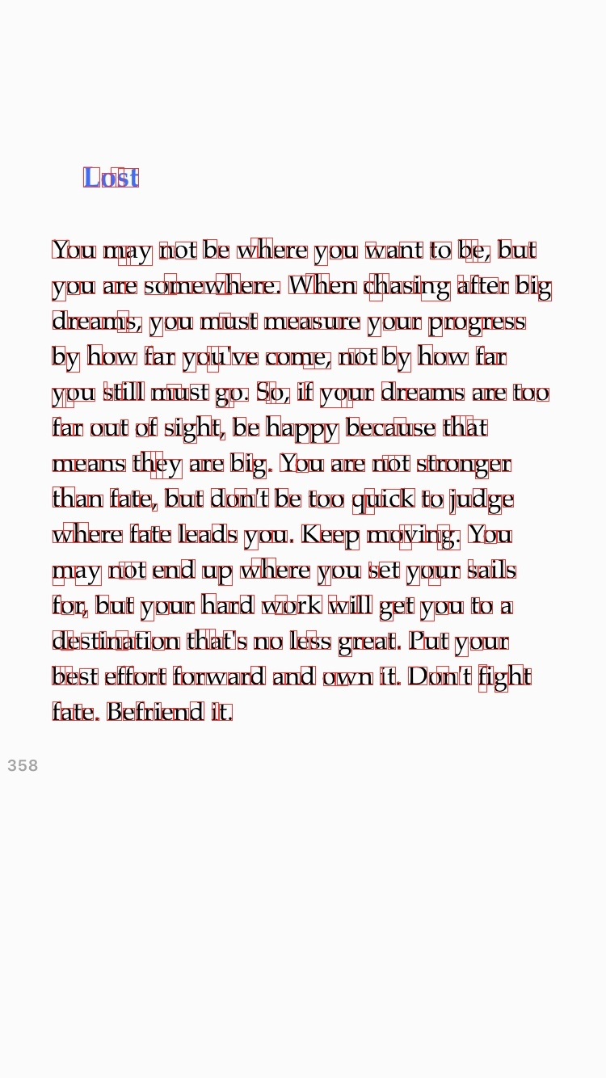

Test Case 1:
Boundary Detection
Contour Detected Text

Slide 28
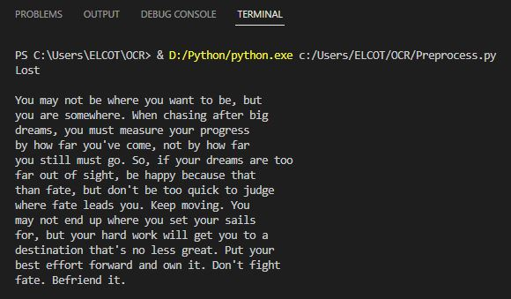
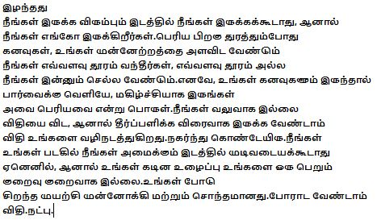
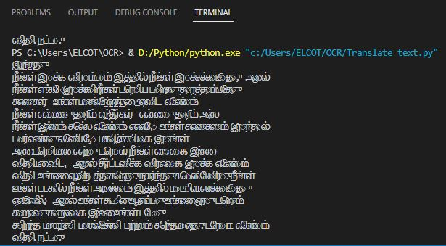
Test Case 1:
Output Text
Translated Text

Slide 29
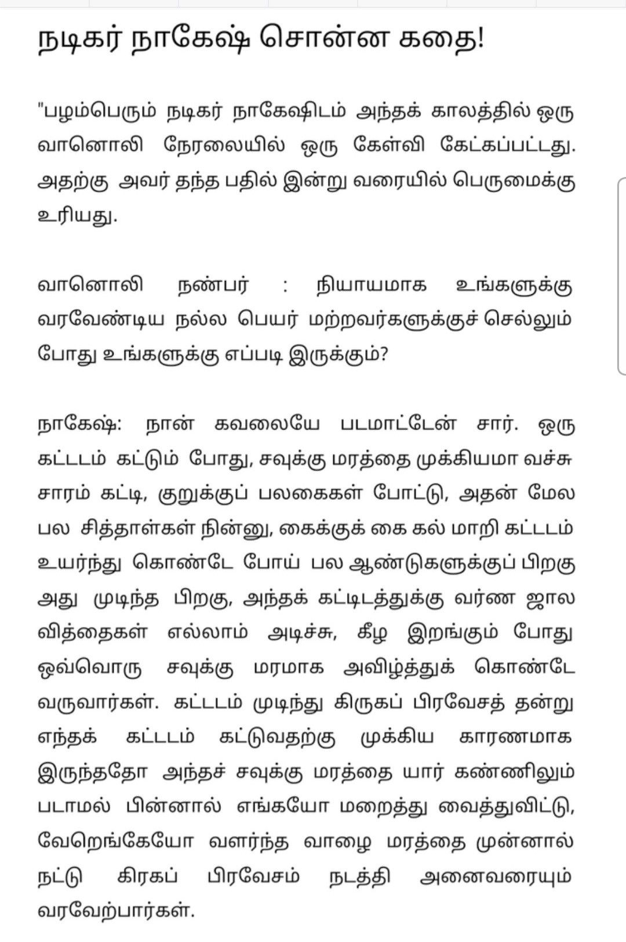

8. RESULT
Test Case 2: Input image contain printed Tamil text
Input Image
Pre-processed Image

Slide 30
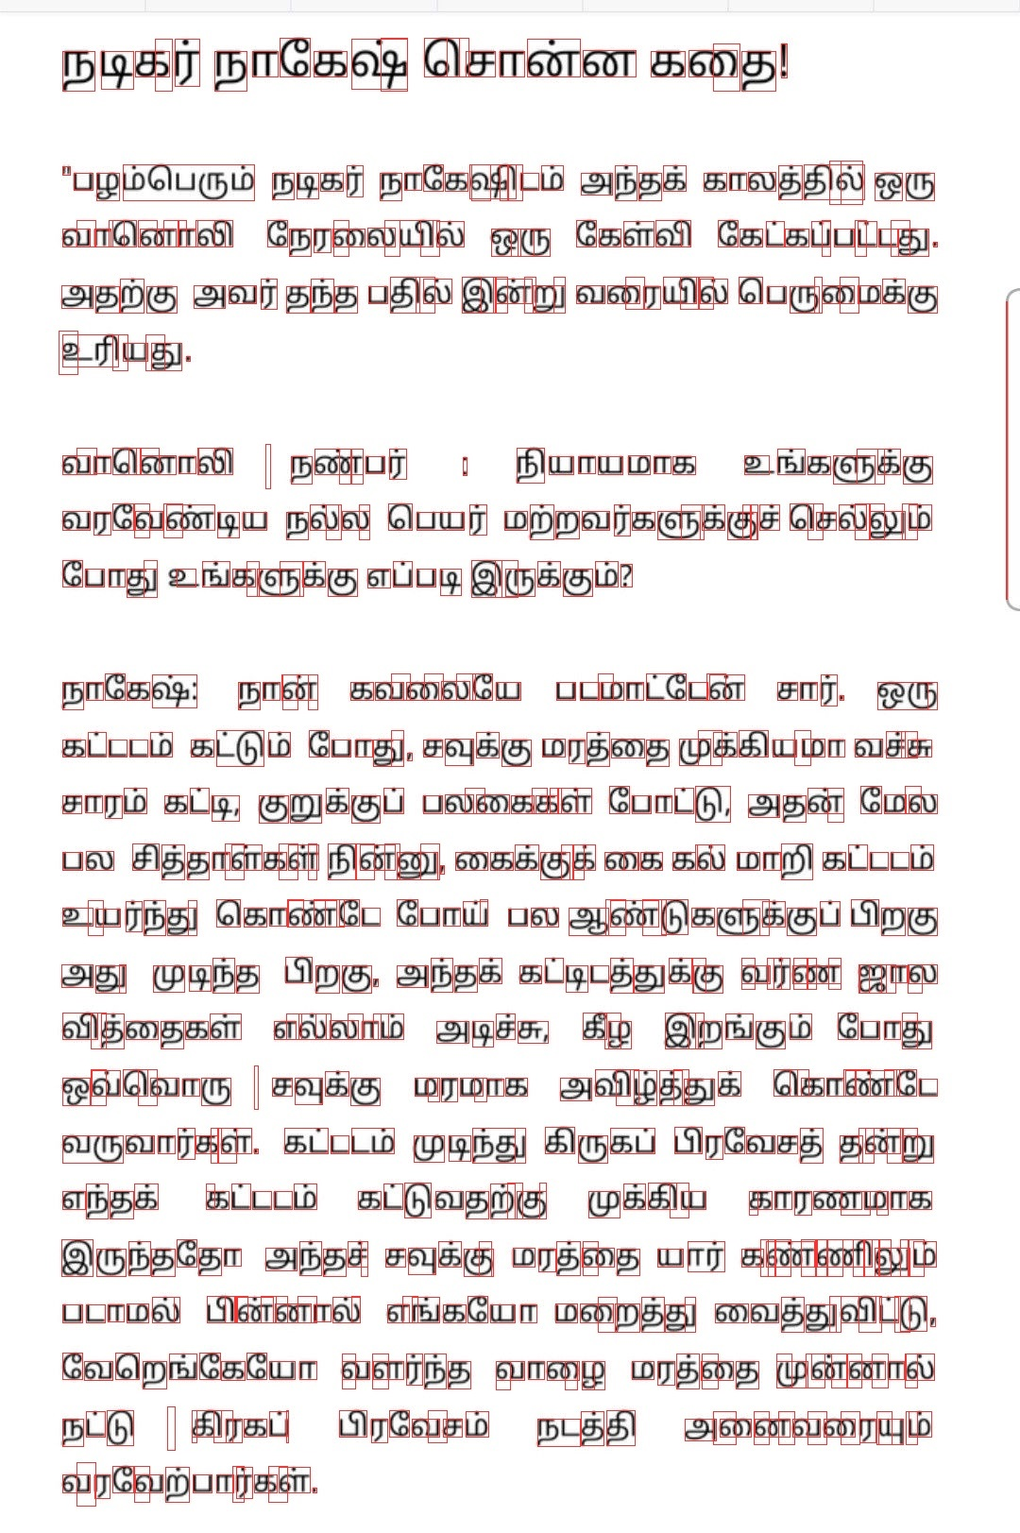
Test Case 2:
Boundary Detection

Slide 31
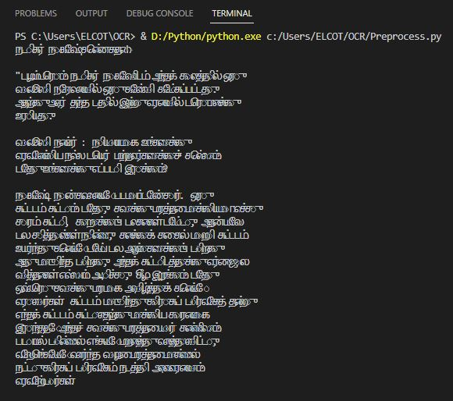
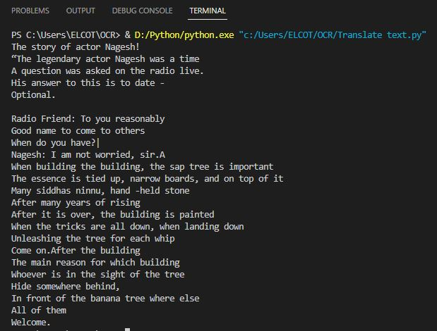
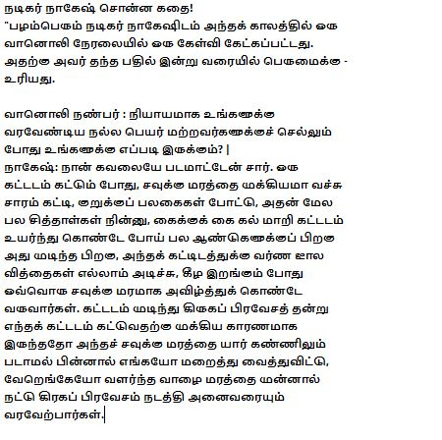
Test Case 2:
Output Text
Translated Text

Slide 32

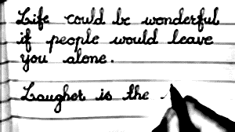
8.1 RESULT
Test Case 3: Input image contain handwritten English text
Input Image
Pre-processed Image

Slide 33
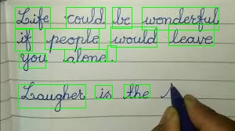
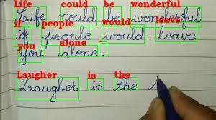
Test Case 3:
Boundary Detection
Contour Detected Text

Slide 34
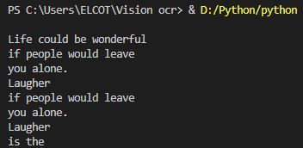
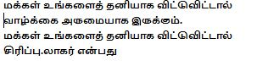
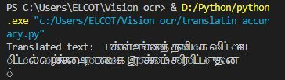
Test Case 3:
Output Text
Translated Text

Slide 35
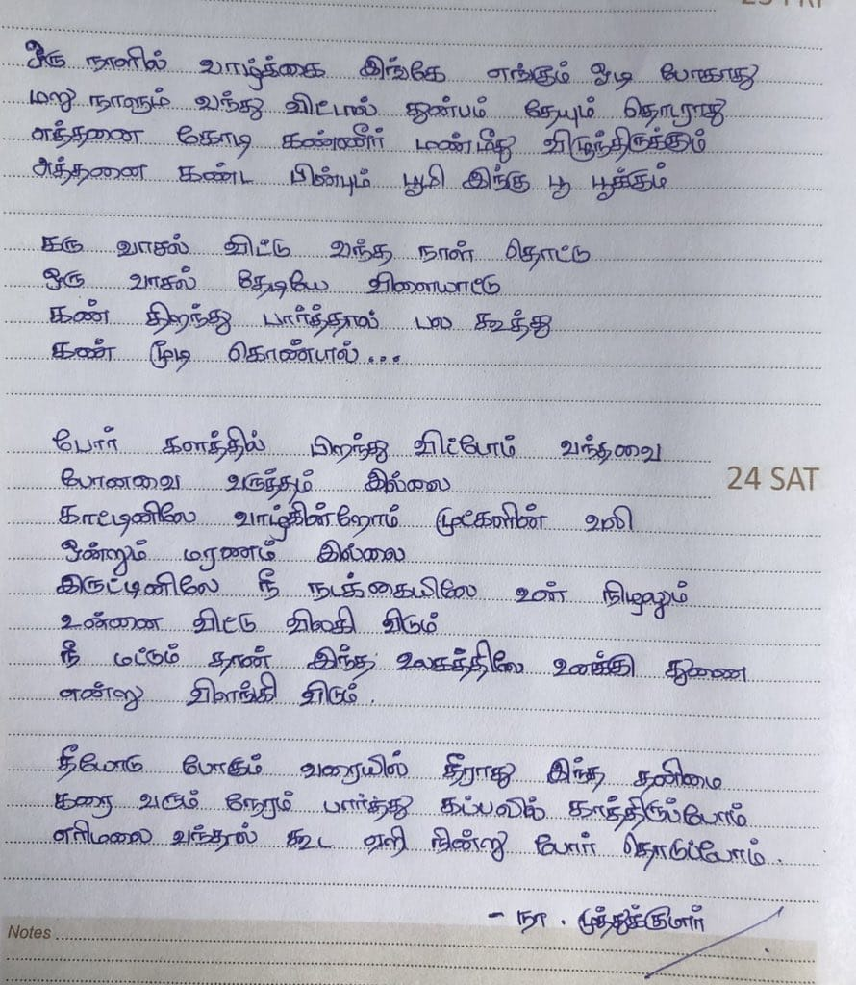
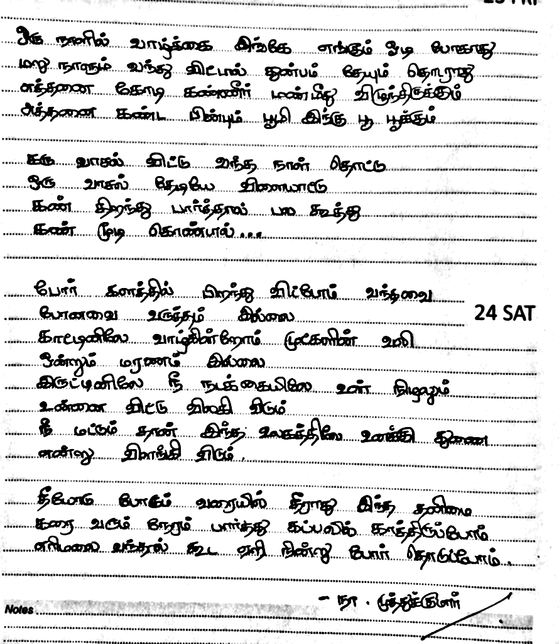
8.1 RESULT
Test Case 4: Input image contain handwritten Tamil text
Input Image
Pre-processed Image

Slide 36
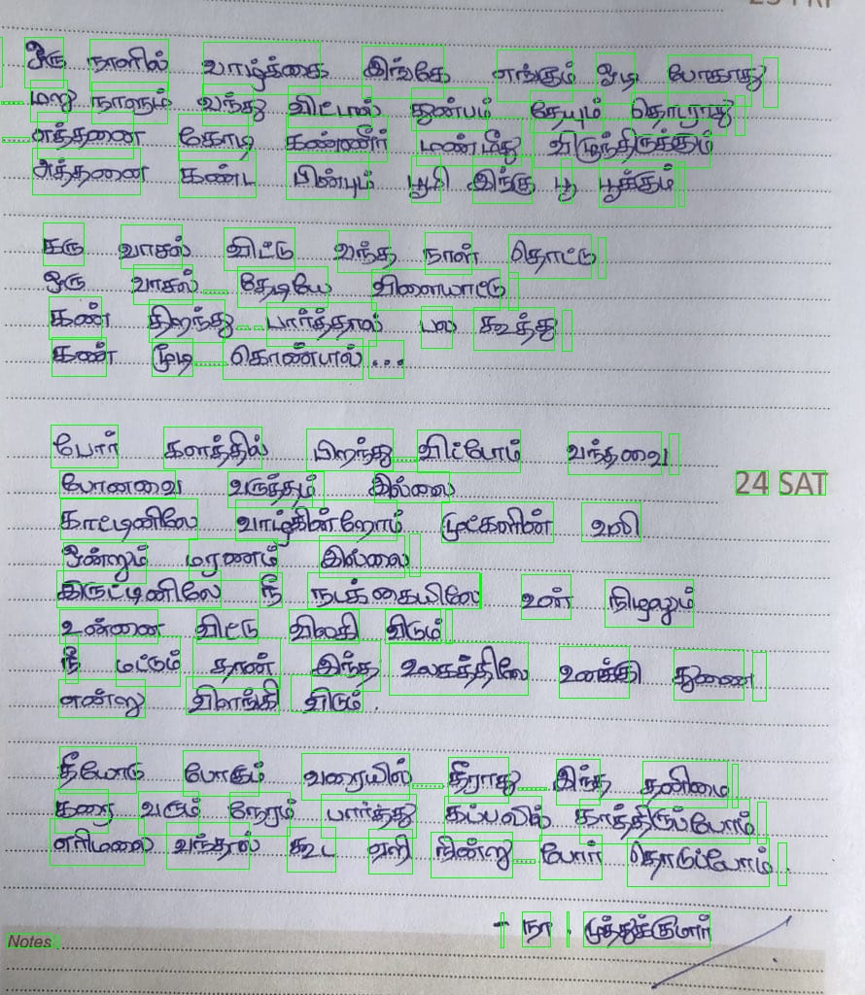
Test Case 4:
Boundary Detection

Slide 37
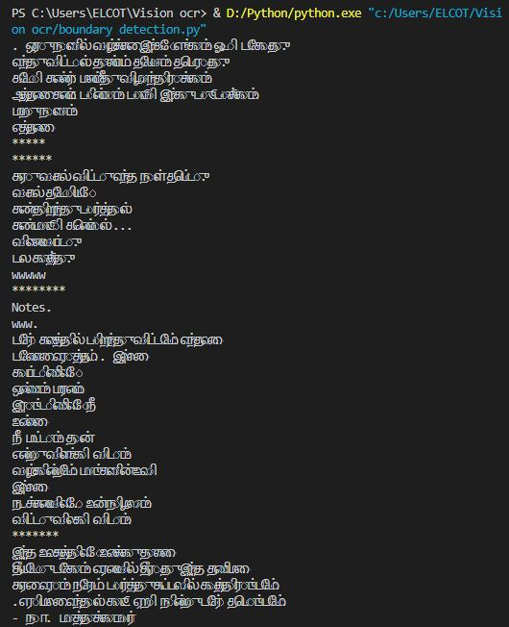
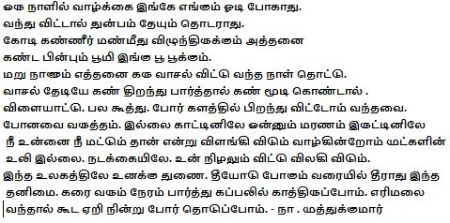
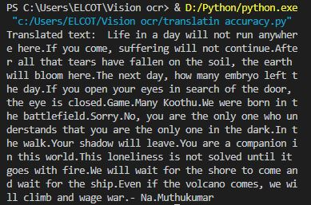
Test Case 4:
Output Text
Translated Text

Slide 38
8.1 RESULT
Test Case 5: Google Cloud Vision Text Detection Accuracy
INPUT TEXT | Accuracy
Printed English Text | 99%
Printed Tamil Text | 98%
Handwritten English Text | 91%
Handwritten Tamil Text | 90%
Average: 94.5%

Slide 39
8.1 RESULT
Test Case 6: Google Translate Accuracy
INPUT TEXT TO TRANSLATED TEXT | Accuracy
English Text to Tamil Text | 94%
Tamil Text to English Text | 93%
Average: 93.5%

Slide 40
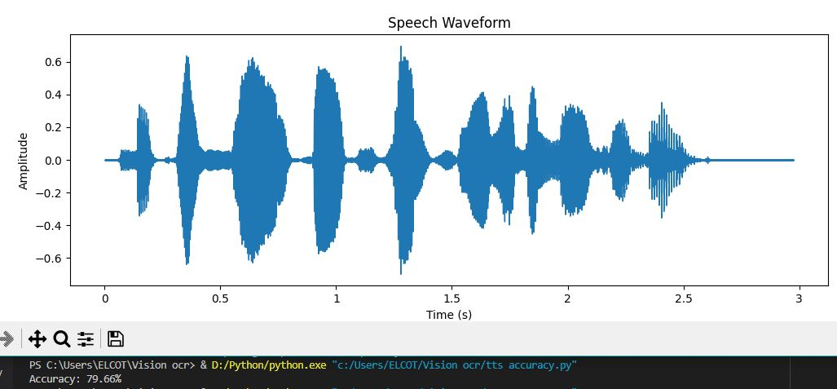
8.1 RESULT
Test Case 7: Google Cloud Text-to-Speech Accuracy

Slide 41
9. CONCLUSION
In this project, a model has been built with Raspberry Pi 4 – based Text to Speech device using Google Cloud Vision API, Translator, and Google Cloud Text to Speech. The Device successfully recognizes text of various fonts from different input images and transforms the OCR output into an audio output, which is extremely accurate. We have implemented Google Cloud Vision Engine because, it is the most powerful and open-source software, and also it requires license/investment. It will assist visually impaired people so that they can read the document using this aiding methodology.

Slide 42
10. FUTURE SCOPE
Motion Sensor-based Text Extraction
Speech Customization
Integration with Natural Language Processing (NLP)
Voice Recognition and Interaction
Mobile Application Development

Slide 43
11. REFERENCES
[1] Dr.S.A. Ubale, Girish Bhosale, Ganesh Nehe, Avinash Hubale, Avdhoot Walunjkar “A Review on Text-to-Speech Converter” International Journal of Innovative Research in Technology, Volume 9, Issue 1, June 2022.
[2] Prof. Mrunalinee Patole, Akhilesh Pandey, Kaustubh Bhagwat, Mukesh Vaishnav, Salikram Chadar Survey on “Text-to-Speech Systems for Real-Time Audio Synthesis” International Journal of Advanced Research in Science, Communication and Technology, Volume 6, Issue 1, June 2021.
[3] Paras Doshi, Yash Shirke, Tejas Hegde, Pranav Dhanvij “Text Reader for Visually Impaired Using Google Cloud Vision API” International Journal of Innovative Research in Technology, Volume 4, Issue 12, May 2018.

Slide 44
REFERENCES
[4] Vaishnavi R.Ambaskar, Vinod M. Lokhande, Dr. Avinash S. Kapse A Review on “Text-to-Speech System” International Journal of Advance Research and Innovative Ideas in Education, Volume 8, Issue 3, March 2022.
[5] Shruti Mankar, Nikita Khairnar, Mrunali Pandav, Hitesh Kotecha, Manjiri Ranjanikar “A Recent Survey Paper on Text-To-Speech Systems” International Journal of Advanced Research in Science, Communication and Technology, Volume 3, Issue 2, January 2023.
[6] Nisha P, Dr.J. Vijayakumar “Survey paper: Text to Speech conversion for visually impaired peoples” International Research Journal of Engineering and Technology, Volume 8, Issue 6, June 2021.

Slide 45
REFERENCES
[7] Sharvari S, Usha A, Karthik P, Mohan Babu C “Text to Speech Conversion using Optical Character Recognition” International Research Journal of Engineering and Technology, Volume 7, Issue 7, July 2020.
[8] Ashanti Widyana, Mohammad Iqbal Jerusalem, Budi Yumechas “The Application of Text-to-Speech Technology in Language Learning” ICOLLITE 2022.
[9] Chooi Shir Ley, Aimi Syammi Binti Ab Ghafar “Handwritten Character Recognition Using Convolutional Neural Network” Progress in Engineering Application and Technology, Volume 2, Issue 1, 2021.
[10] Karun Somasunder M, Amal J.S, Gopal Gopakumar, Suraj V Thomas, Keerthi Krishnan “Text to Speech Conversion Using Google Vision API” International Journal of Innovative Research in Technology, Volume 8, Issue7, 2021.

Slide 46


